Slide 1
Social Impact of War in Ukraine SIWU Guillaume Allègre, François Geerolf, Xavier Timbeau

Slide 2
Bad but not Catastrophic (Krugman)
Increase in prices of
Grains
Oil
Natural Gas
Electricity
Increased volatility
Panic bid (relaxing)
Stock building (natural gas, grains, oil)
Anticipation of embargo

Slide 3
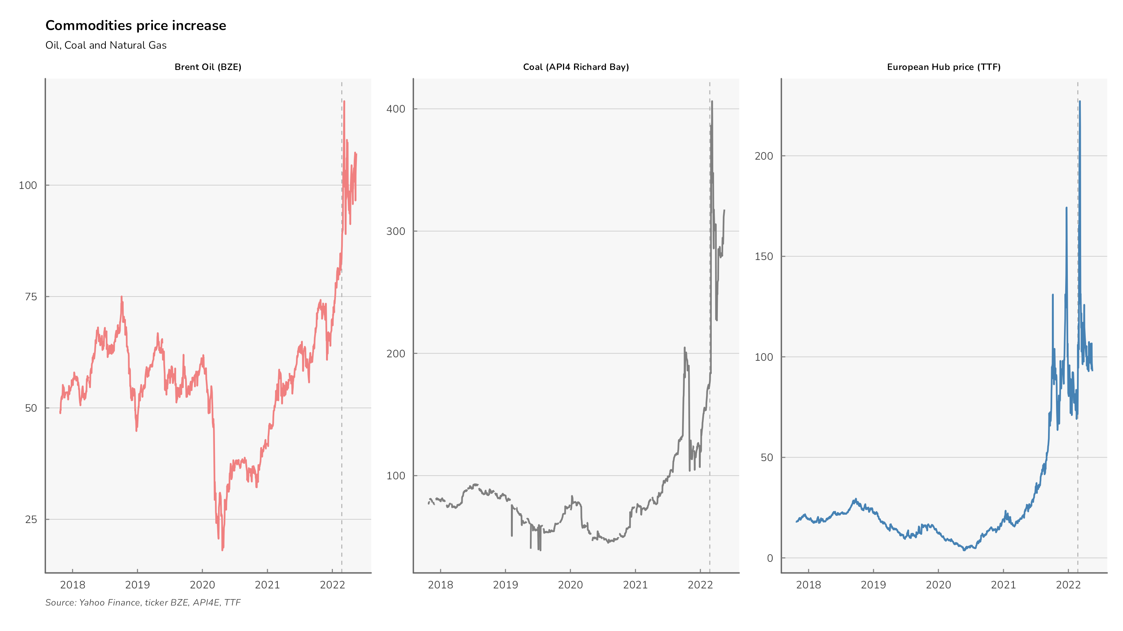
Commodities

Slide 4
Methodology
Identification of relevant COICOPs
We identify the prices that have experienced a significant increase between several dates, mainly between February and March, 2022, which can be attributed to the invasion of Ukraine. We use Eurostat's HICP at the level 3 of disaggregation according to the COICOP nomenclature to distinguish price increases in (notably) energy, food, housing and transport. Data for April 2022 for Eurostat HICP will be available on the 18th of May, 2022 and graphs will be updated on the companion website. In the present brief, we comment data up to March 2022 only.
Eurostat’s Household Budget Surveys (HBS 2015)
In order to identify the structure of consumption by income quintile (using hbs_str_t223 database).
Impact of price hike on impacts
We then estimate the impact of price hikes in euros and in % of income by income quintile for each of the member states of the Union and per product identified using HICP from Eurostat, from which seasonal patterns are removed (allowing monthly analysis).
Vizualisation
We offer an analysis and visualization of the information. Updated and complementary data are accessible at https://ofce.shinyapps.io/siwu/

Slide 5
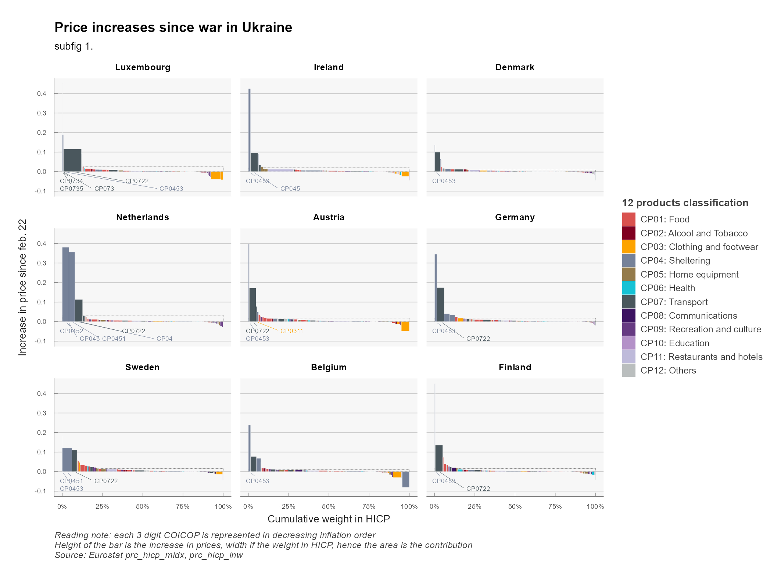
Price hikes (1/3)

Slide 6
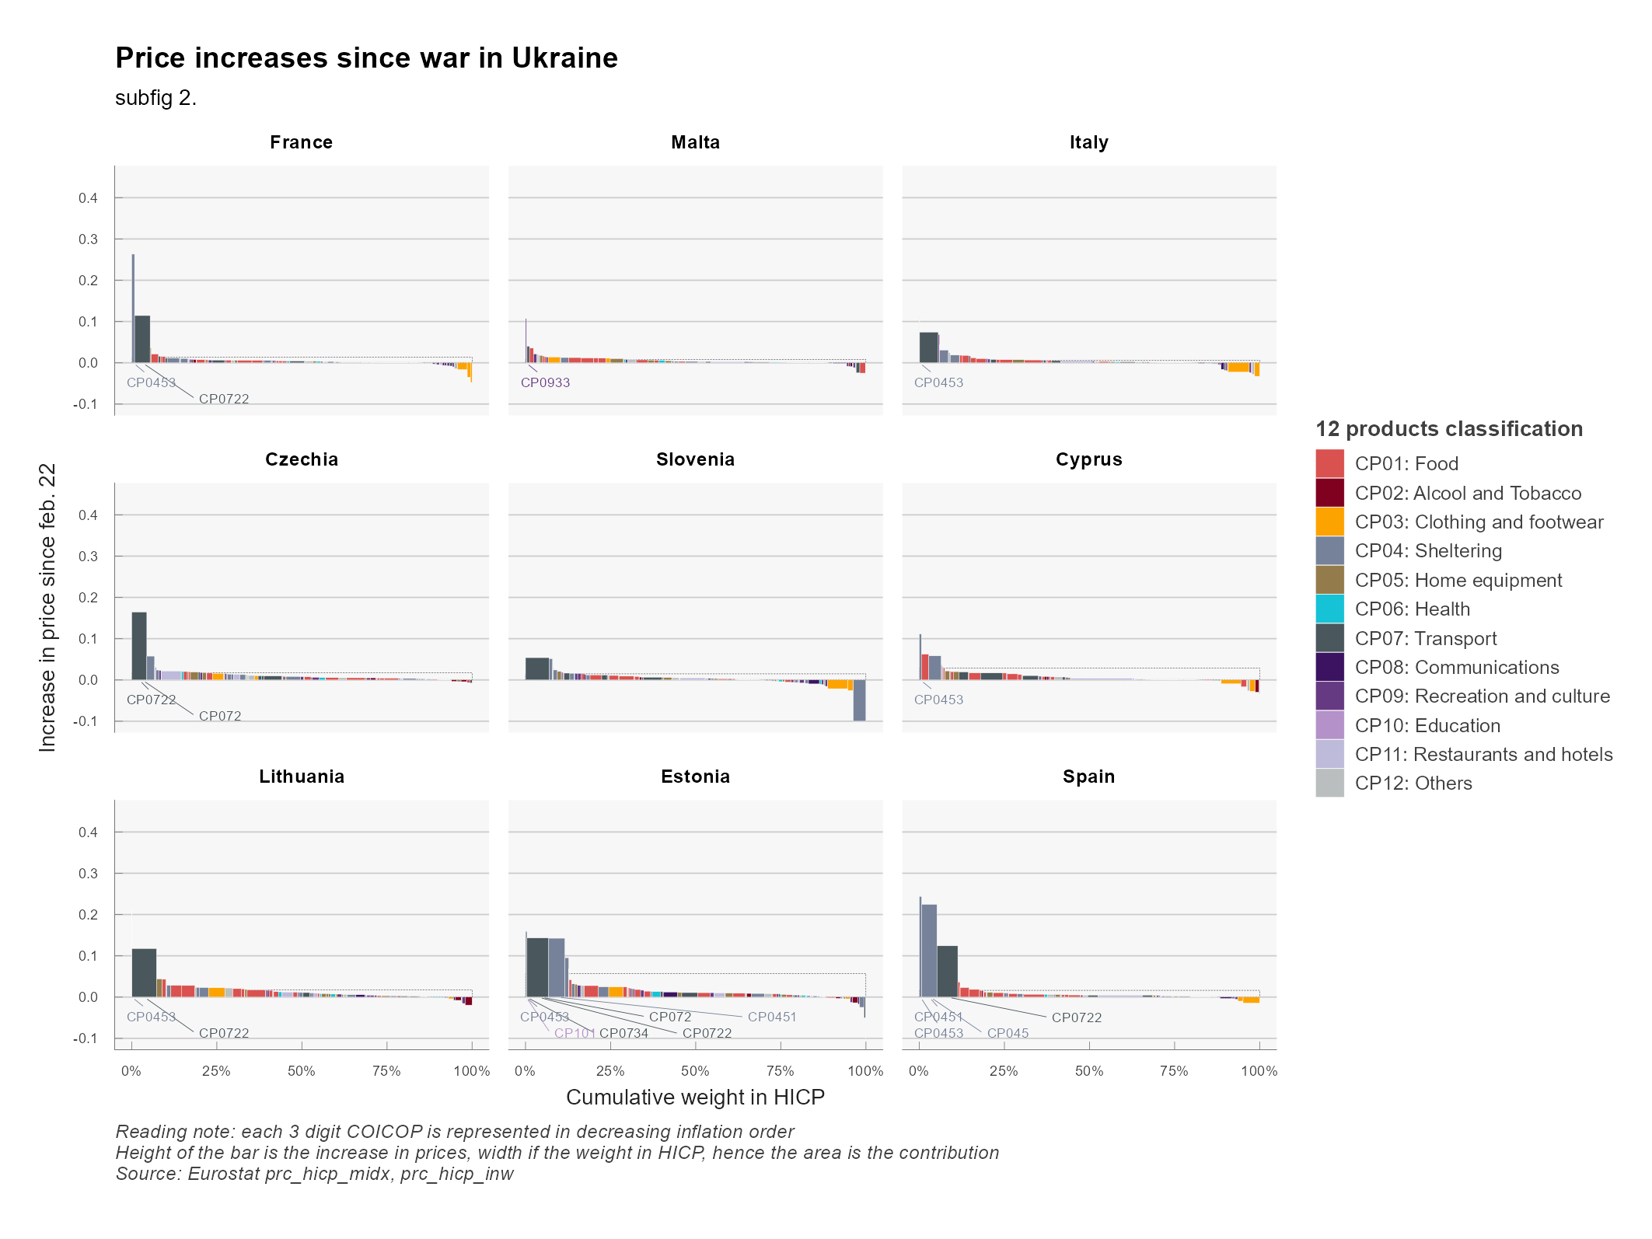
Price Hikes (2/3)

Slide 7
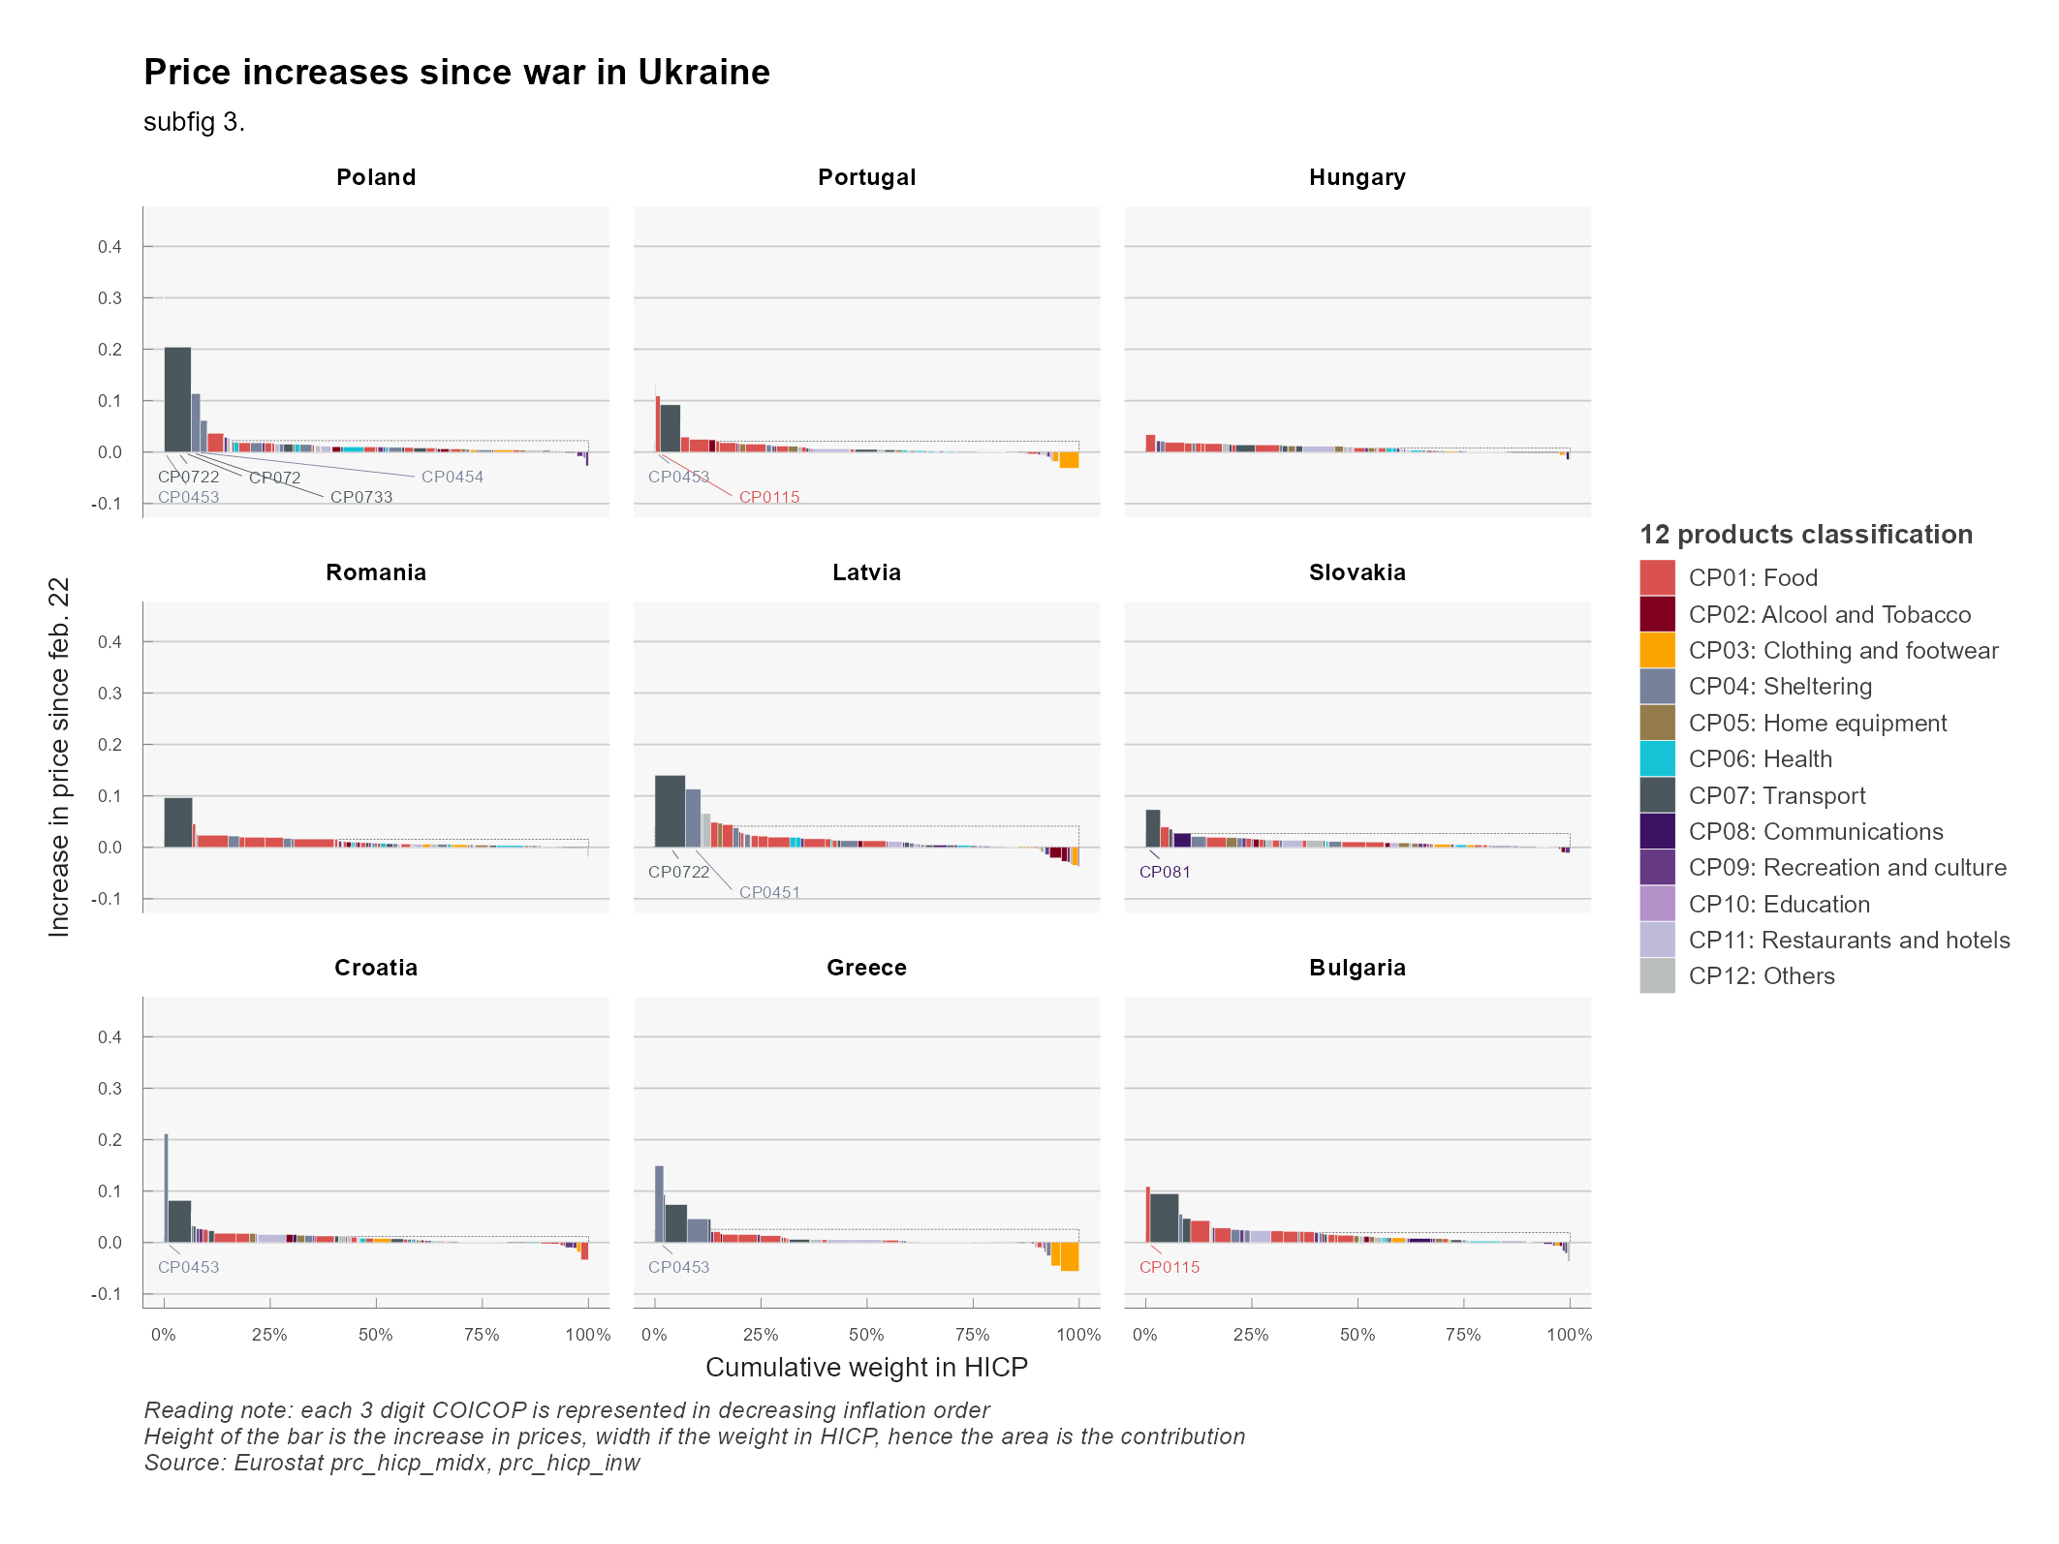
Price Hikes (3/3)

Slide 8
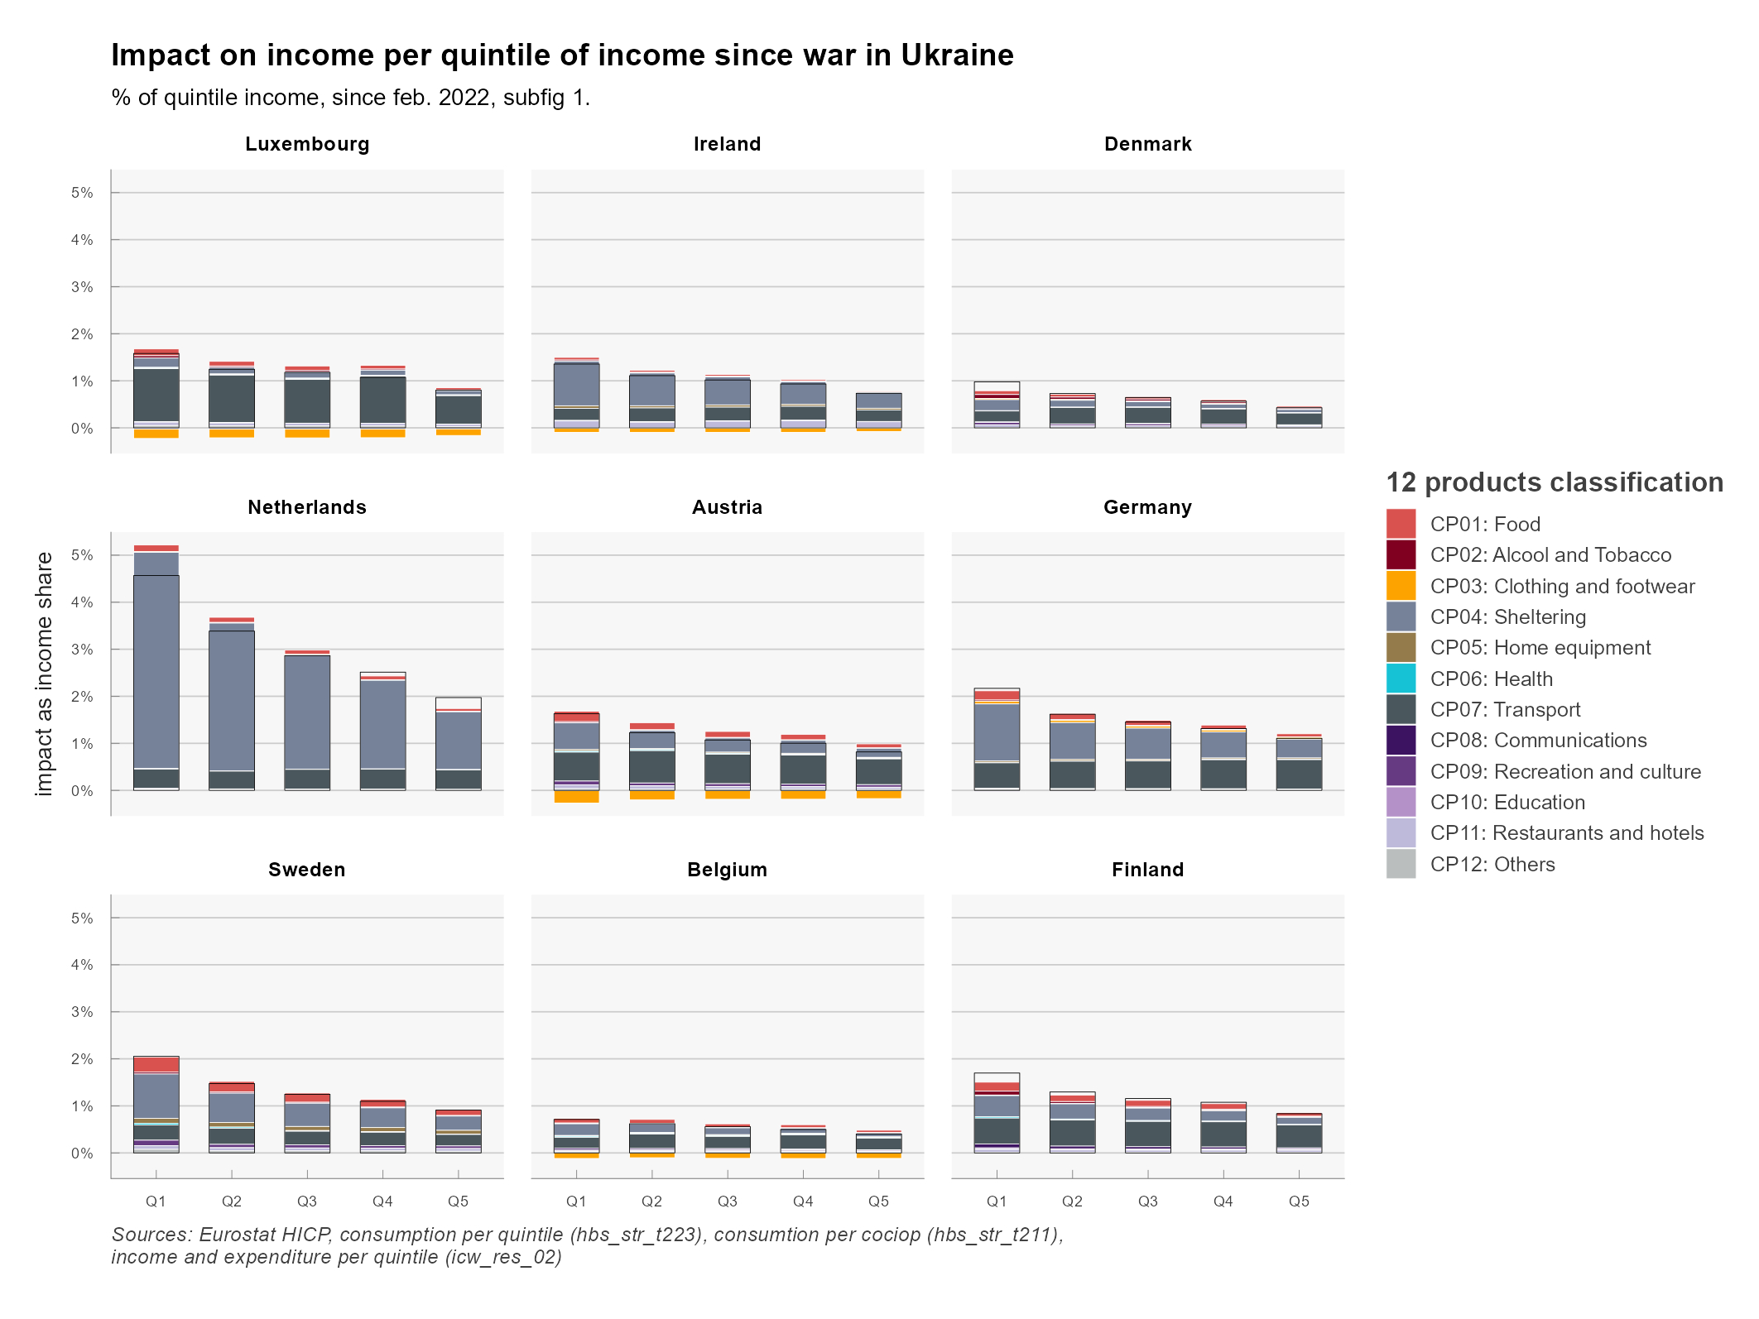
Impacts per quintile (1/3)

Slide 9
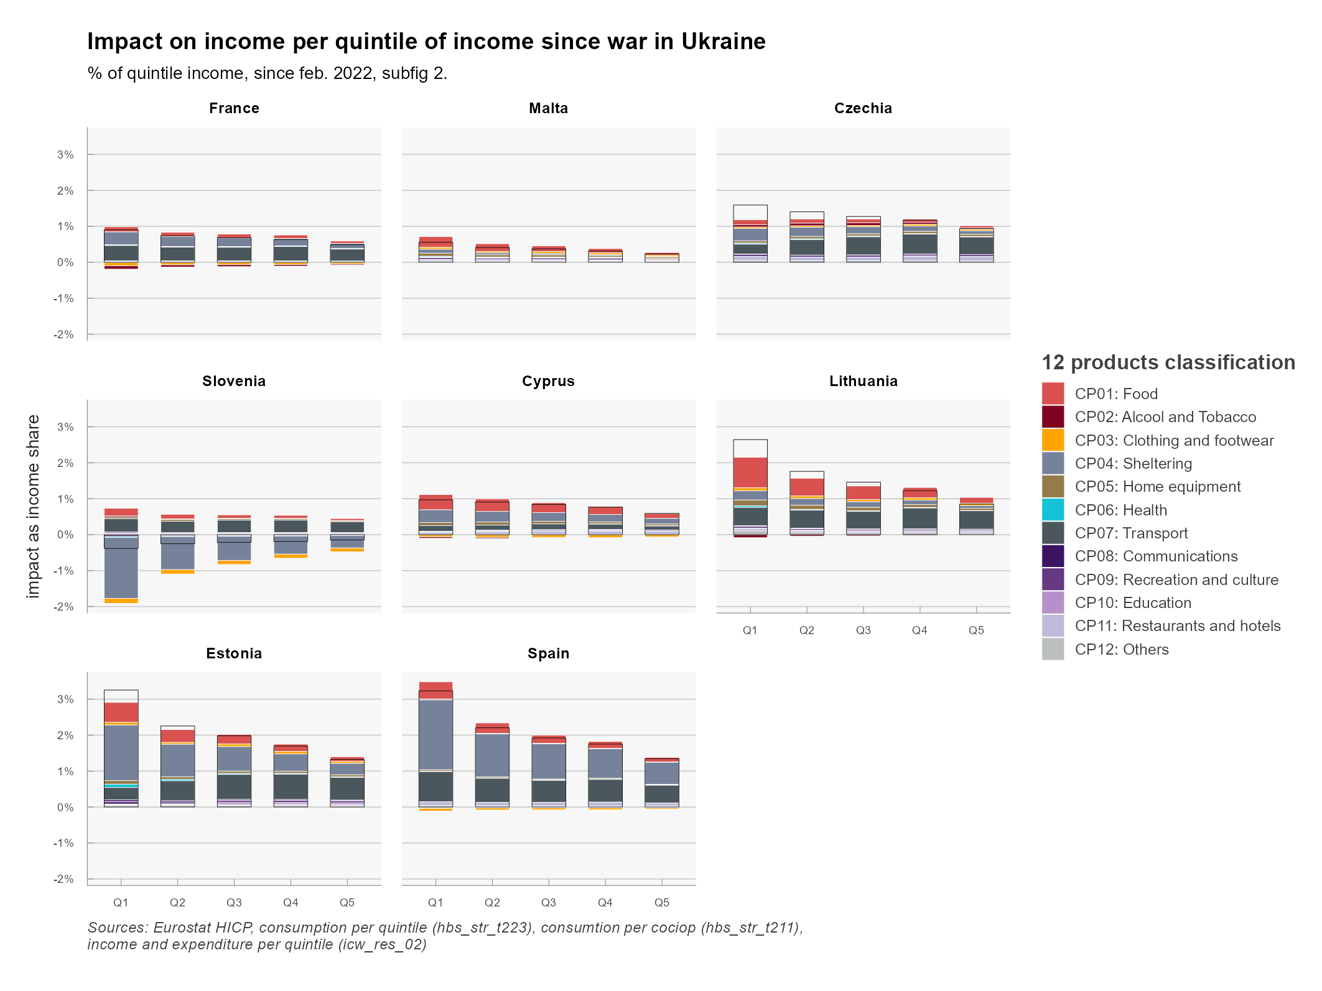
Impacts per Quiintile (2/3)

Slide 10
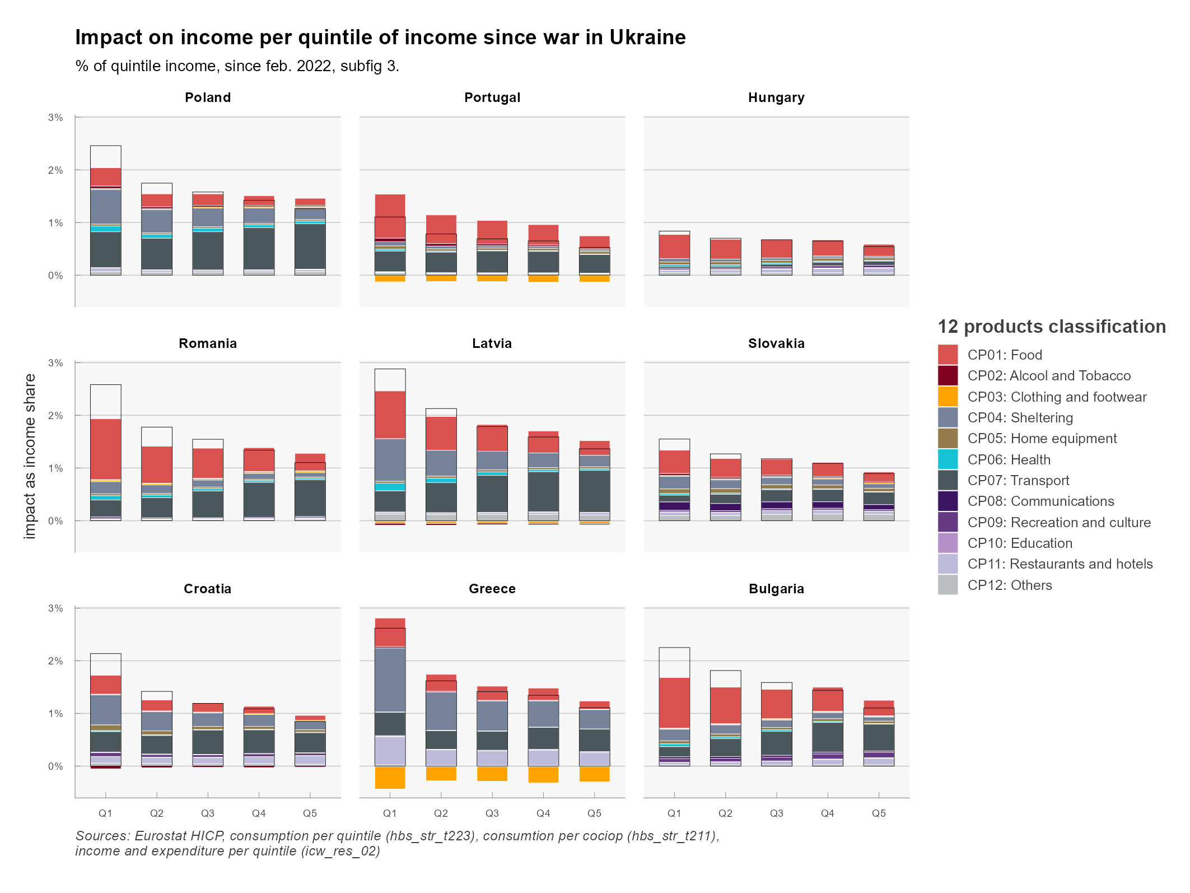
Impacts on quintile (3/3)

Slide 11
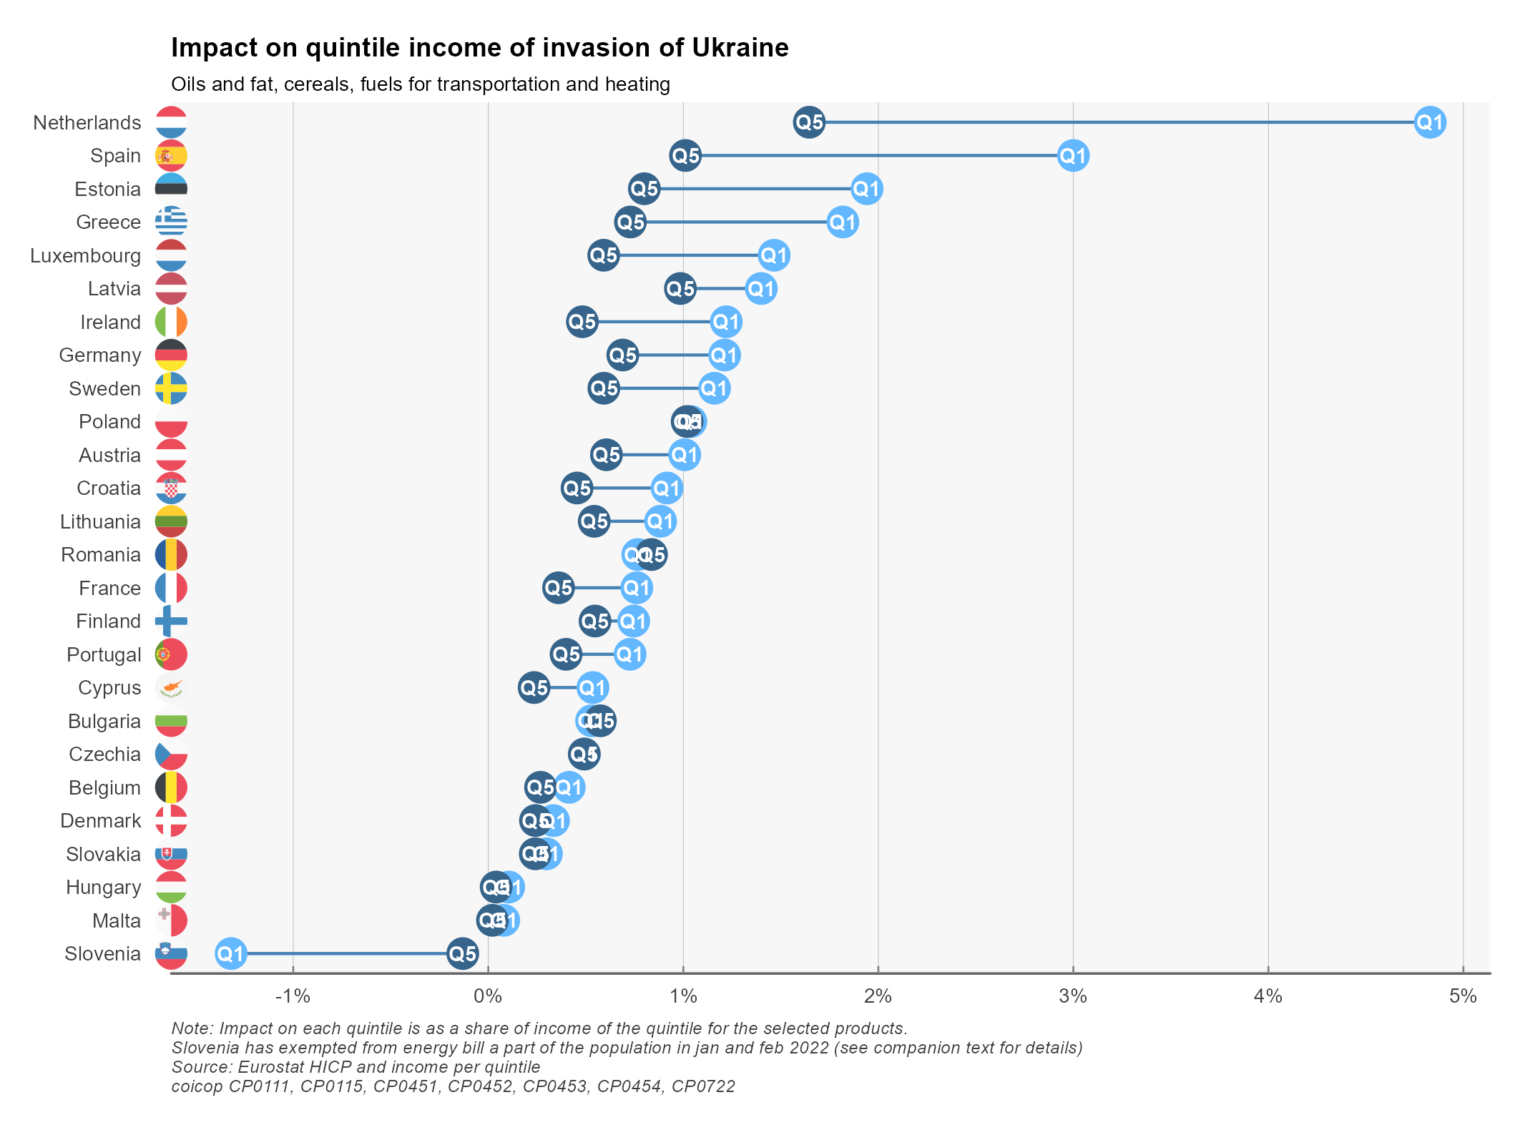
Summary

Slide 12
Poverty Rate ?
Poverty rate is a central indicator for inequality
Based on income, with no price differential between indivdual
Unable to capture relative prices evolution and differentiated consumption shares
Take in account compensation (checks for price increases)
Can bring paradoxical results : stable in most countries (including Slovenia), decreasing where checks are sent (eg France)
Material and Social Deprivation is more relevant
But no data and hard to predict as substitution can occur and depend on relative prices
So we prefer the aprach
At risk of poverty is mixing the 2

